Slide 1

Federal Government Contracts Analysis
By:
Ericka, Hythem, Taoule, Edwin

Slide 2
The study
To determine the correlation between Government grants and the fluctuation in the employment rate
To Determine the effect on the united states GDP
To determine a correlation between the number of contracts granted by the US. Federal Government and the employment growth rate per state focusing on the Tech industry

Slide 3

The What, Why, and how?
What: there are many factors to move the economy forward, we will focus on a key metric “The Federal Government procurement program”
Why: we believe that the program is very essential to our growing economy here in the us and we would like to showcase that using our code.
How: did you say code? we will utilize our research and gts skills to showcase how we used code to import, organize, merge, set tables, edit, graph and data manipulate.

Slide 4
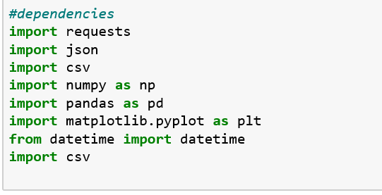
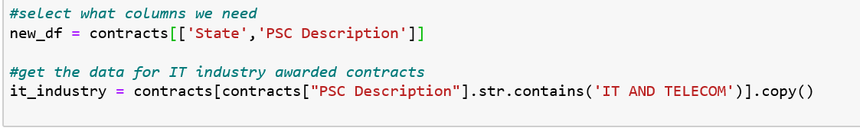
How did we go sort the data
Import dependencies
Rename columns and such..

Slide 5
The Federal Government procurement effect on Employment rate

Slide 6
The Federal Government procurement effect on GDp in the US

Slide 7
Conclusion:
IN CONCLUSION, TIME IS YOUR MOST VALUABLE RESOURCE, LEARN HOW TO MANAGE IT.

